Slide 1
Portfolio Analysis
Manel Ait Amer & Sebastian Brockschmidt

Slide 2
What is it about?:
We have 3 differents data set that we used in our quest:
Asset_price_data.csv / portfolio_weights.csv / asset_information_data.csv.
Portfolio analysis is a systematic way to evaluate investment portfolios to optimize asset allocation and management. It involves a variety of financial metrics and visualizations to assess the performance and risk of different financial assets.
Understanding the composition of the portfolio, including the distribution of assets across different categories and their respective weights, helps in managing and optimizing the portfolio for risk and return.

Slide 3
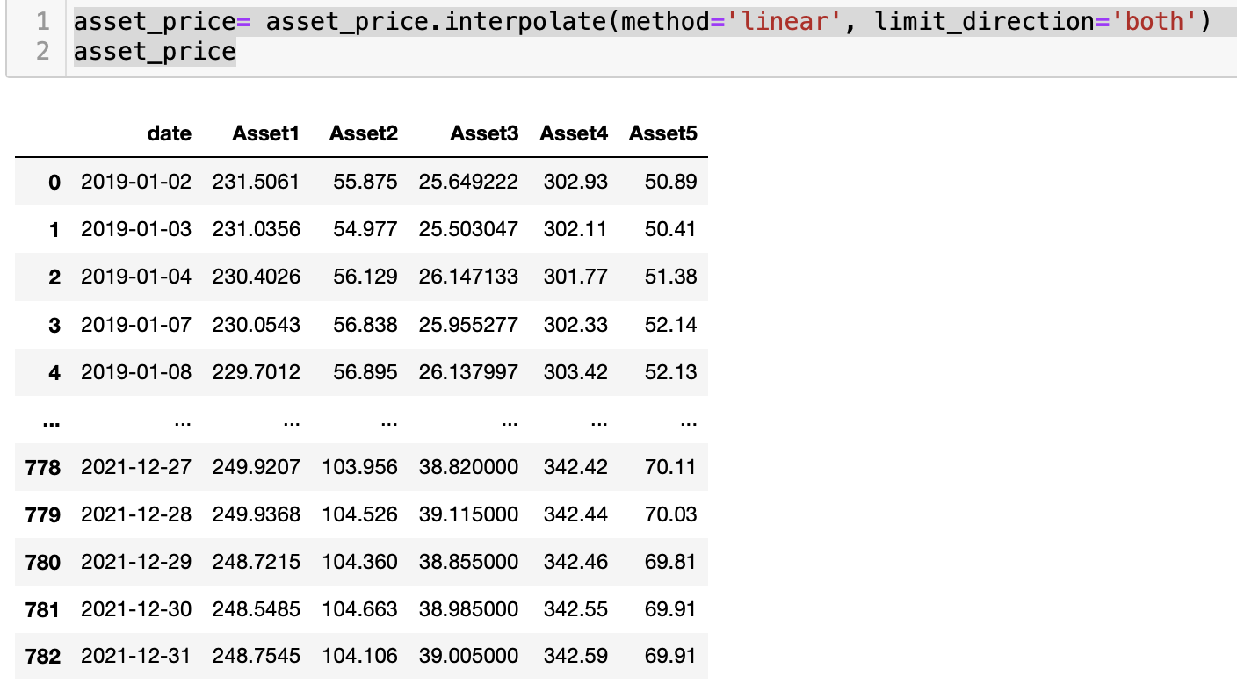
Cleaning the NaN:
We have some NaNs in the asset_price_data.csv.
We filled the NaN with the average price of the date after and before.
We can also fill it with ffill (forward value) and bfill (backward value) methods.

Slide 4
Time series graph :
We visualize the asset_price_data.csv. Data through a times series graph using the normalized function (dataset where the values have been adjusted or rescaled to a common scale or range) . The goal is to capture and compare trends in asset performance over time.
We can focus on relative changes in asset prices, this allows for a more meaningful comparison of the performance of different assets within the portfolio.

Slide 5
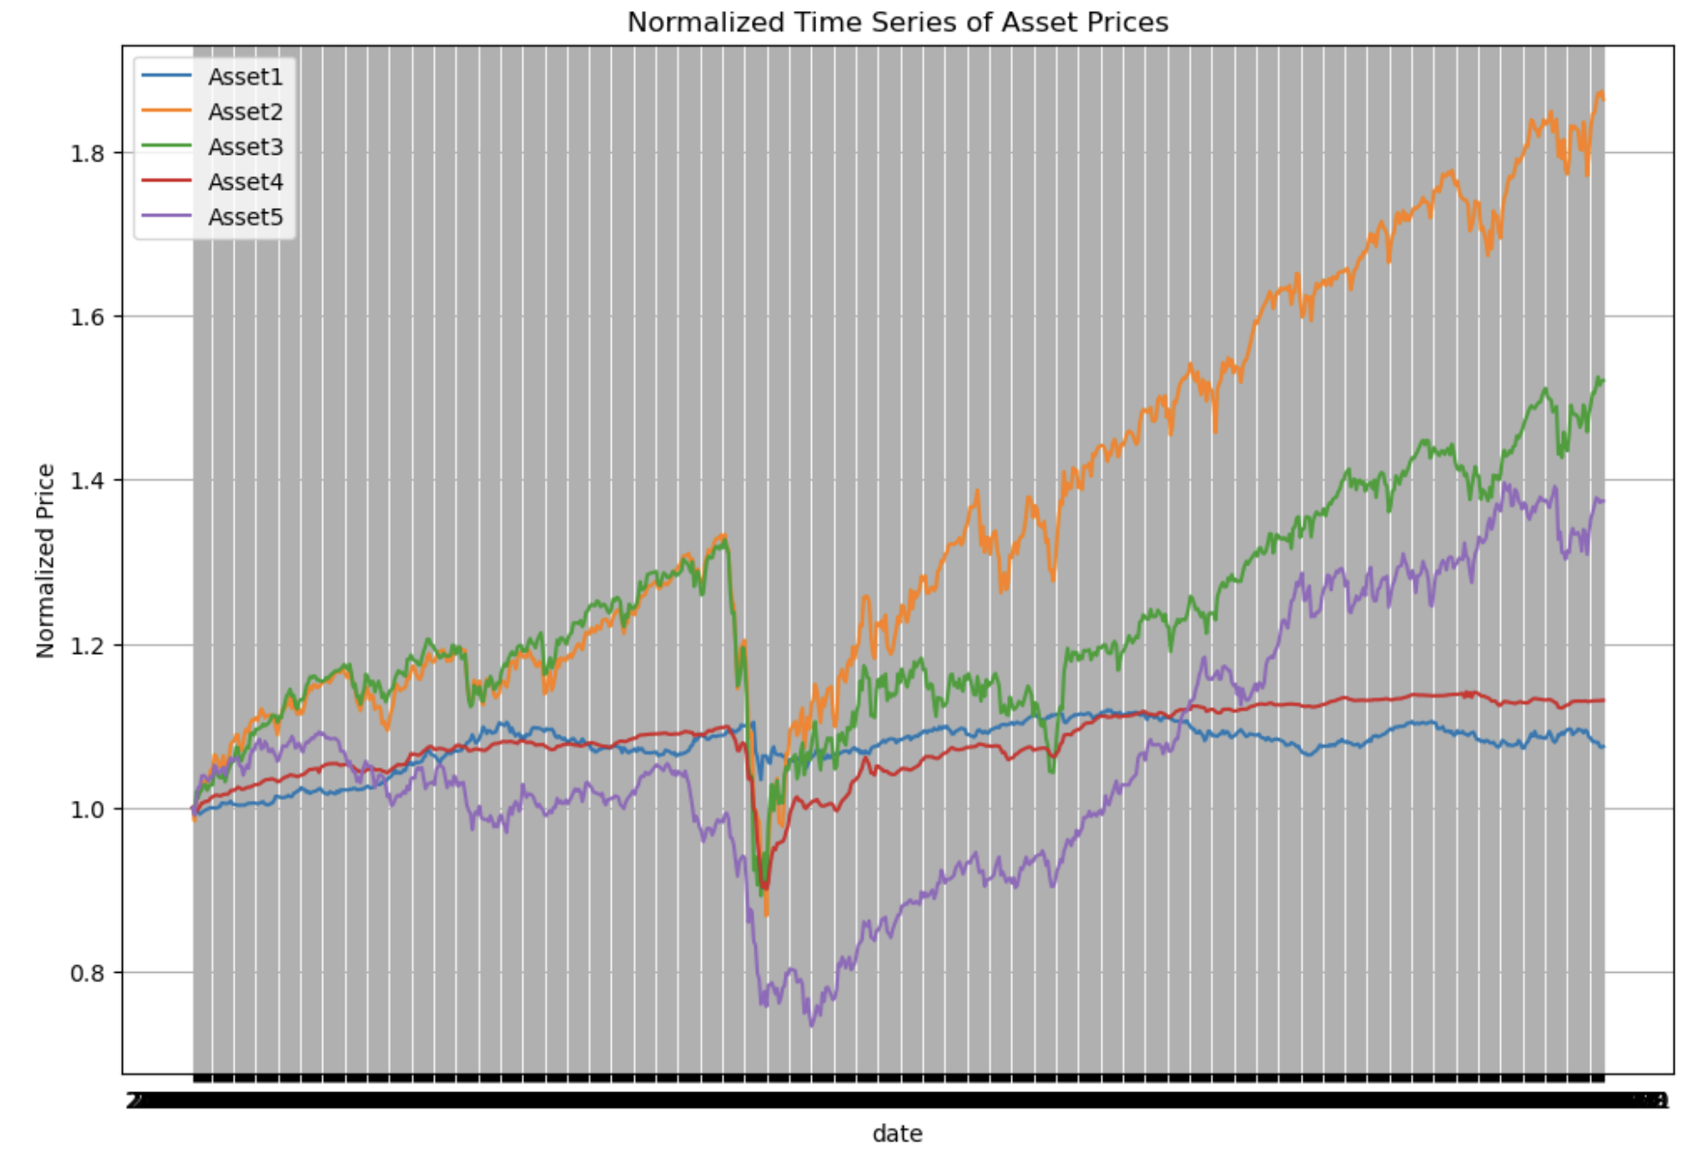
How the visualization looks like?

Slide 6
Returns Analysis:
The goal here is to analyze the relationships between the daily percentage returns of different financial assets using the correlation matrix and scatter plots.
This analysis helps to understand how the returns of one asset relate to the returns of another.
We calculated the correlation between the 5 assets.
We also tried to see the scatter plots between Asset1 and Asset2. (we can try it with any 2 assets).

Slide 7
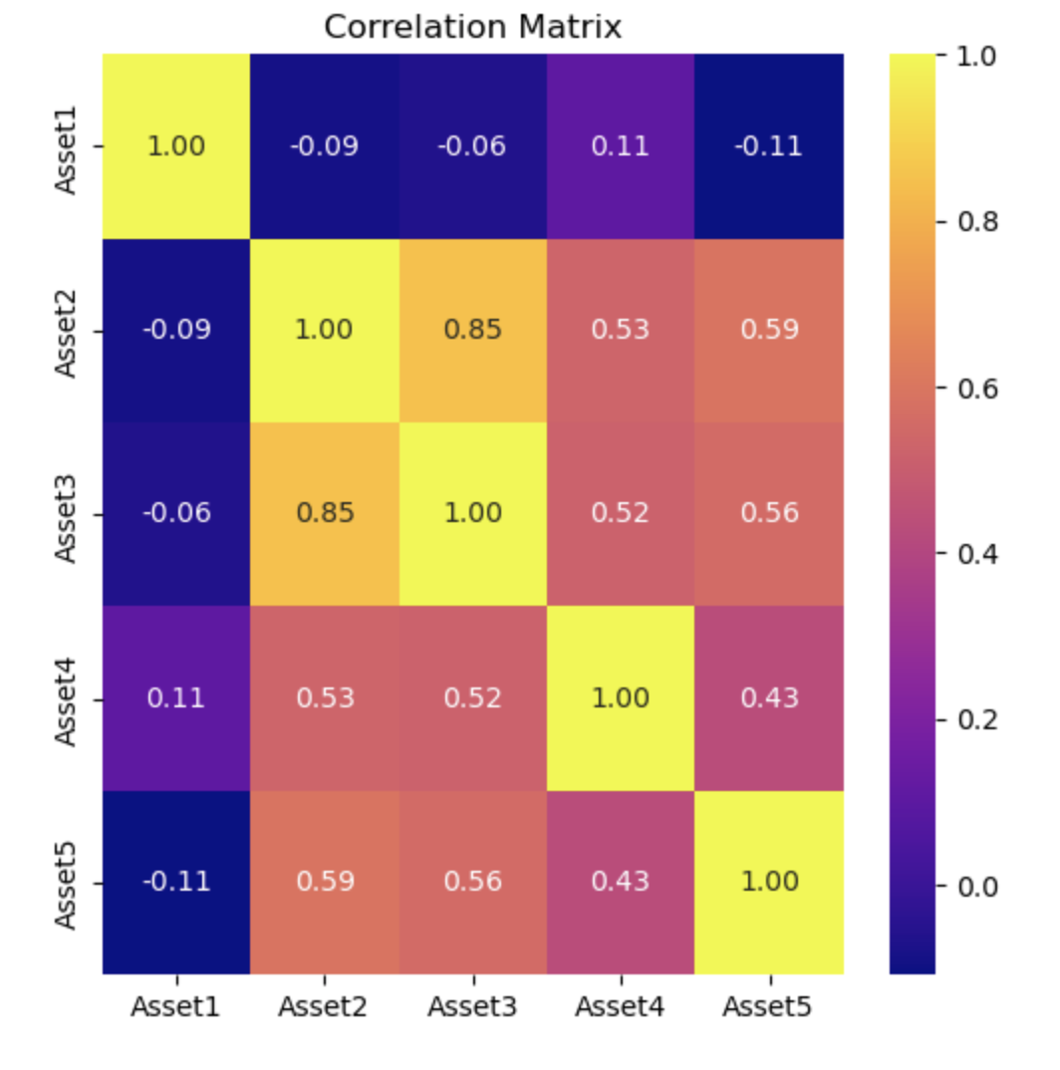
Correlation between Assets:
The closer the correlation coefficient is to 1 or -1, the stronger the correlation.
A correlation coefficient of 0 indicates no linear relationship between the variables.Values closer to 0 indicate weaker correlations.
Positive correlation: When one variable increases, the other tends to increase as well.
Negative correlation: When one variable increases, the other tends to decrease.

Slide 8
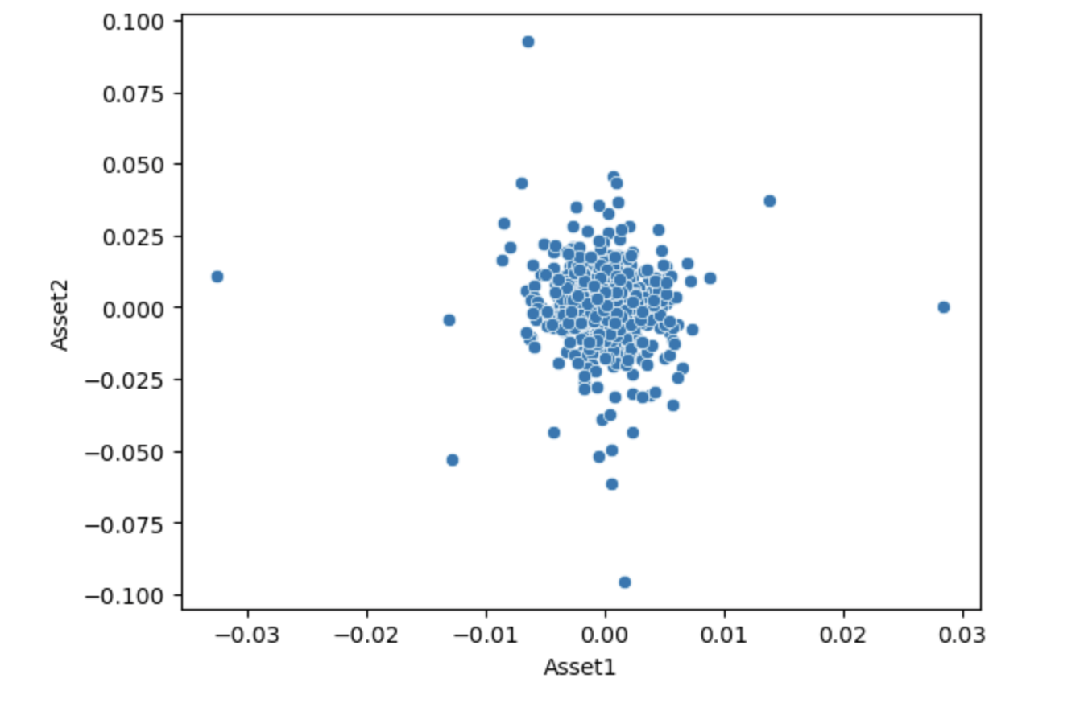
Scatter Plot between the Returns of Asset1 and Asset2:

Slide 9
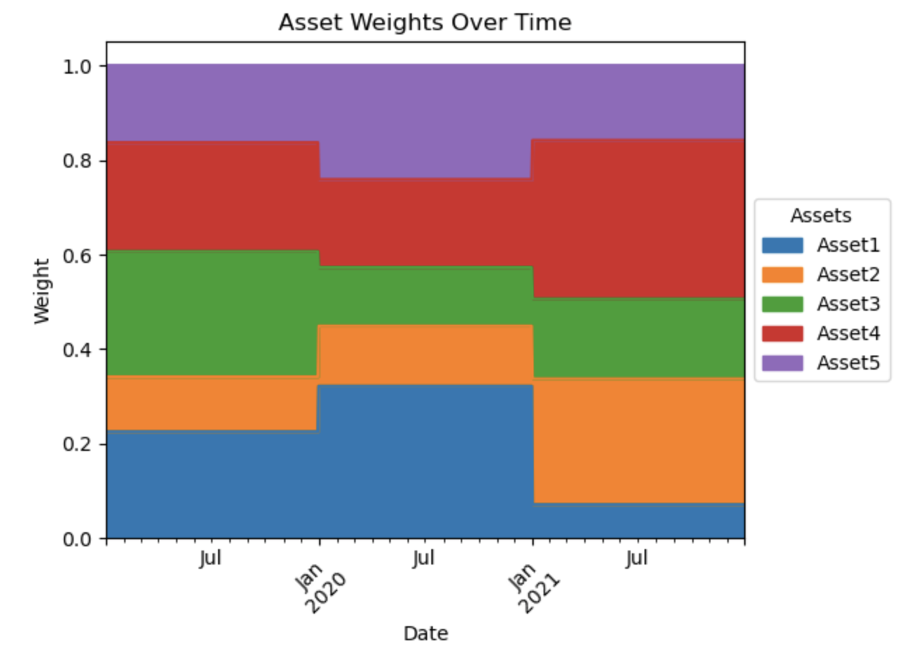
Portfolio Analysis:
Creating an area chart is to visualize the daily weights of each asset in the portfolio. This chart helps to understand the allocation of the portfolio across different assets over time.
And for that we will use the portfolio_weights.csv data.

Slide 10
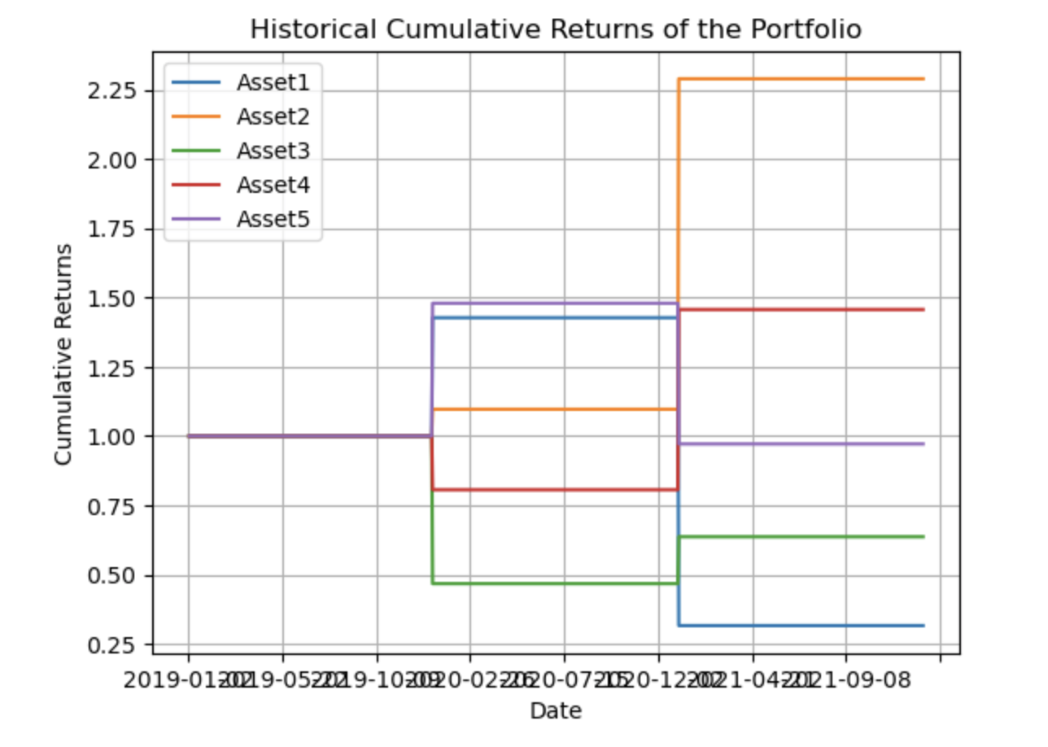
Chart of Historical Cumulative Returns of the Portfolio:
The line plot shows the trend of cumulative returns over time. As the line moves upwards, it indicates an increase in cumulative returns, meaning the portfolio is earning positive returns. Conversely, if the line moves downwards, it indicates a decrease in cumulative returns, implying negative returns.

Slide 11
Annualized returns and volatility:
The annualized return of the portfolio, which represents the average annual return earned by the portfolio over the given period.
The annualized volatility of the portfolio using an annualization factor of 261 days. Volatility measures the degree of variation of the portfolio's returns over time and is an important metric for assessing risk.

